Slide 1
Inequality by Demographic Factors
Findings from Individual-Level Cantonal Tax Data
Oliver Hümbelin und Rudolf Farys
Notes:
<Nummer>

Slide 2
Introduction
Income inequality is often understood as a result of unequal wages which is moderated through redistribution. But how is income inequality related to demographic factors or demographic changes?
Current Demographic Development in Europe: Older, more numerous and diverse (Demography report 2010)
In Switzerland the picture is similar:
Swiss Population is ageing (Share of 65+: 1980: 14%, 2012: 17%, estimated in 2030: 24% Source: ESPOP, STATPOP, SCENARIO)
Household types are changing
In the last 30 years Population grew by 1.8 Mio (Source: STATPOP)
A central part of the growth is due to migration (average annual net migration since the 1980 is +28’000 Source: PETRA/STATPOP)
Notes:
Bevölkerung nach Alter
http://www.bfs.admin.ch/bfs/portal/de/index/themen/01/02/blank/key/alter/gesamt.html
Migration und Integration
http://www.bfs.admin.ch/bfs/portal/de/index/themen/01/07/blank/data/01.html
<Nummer>

Slide 3
Theories and «claims»
Demographic change and inequality – Why does demography matter?
Ageing of a society and age groups
Ageing of the population leads to a conflict between generations (Kaufmann 2005), because the financial feasibility of social security is being tested. (see also Budowski & Nollert, M. (2010) > between group differences
Schellenbauer (2013): «In a world where wages depend only on the age of the workforce and are otherwise completely evenly, annual cross-section results leads to substantial inequality due to the age differences within society » > between group differences affect overall inequality
Notes:
Schellenbauer-These: Unterstellt einen linearen Zusammenhang zwischen Altersgruppen und der Höhe des Einkommens
<Nummer>

Slide 4
Theories and «claims»
Demographic change and Inequality – Why does demography matter?
Change of household structure and household types
In social policy research between household differences are of interest (Fritschi & Bannwart 2013) > between group differences
Change in the «way of people living together» affects inequality (people marry later, and divorce more often). Daly and Valetta (2006) think that part of the rise in inequality in the US is due to the rise of people living alone (especially single parents). (See Peichl et al. 2011 for Germany) > between group differences affects overall inequality
Notes:
Weiterer Punkt: Between group differences are particularly interessting for Familienpolitischen Verteilungsfragen. Es Unterschiede zwischen verschiedenen Haushaltsformen> Unterschiede zwischen Haushalten mit und ohne Kinder. Aber auch bezüglich allgemeinen Verteilung
Üblicherweise wird Einkommensungleichheit primär als Ausdruck von Lohnunterschieden verstanden.
<Nummer>

Slide 5
Theory and Research Question
Demographic change and Inequality – Why does demographic matters?
Two inequality-relevant «processes» must be separated, when linking demographics to inequality
(1) Demographic changes can affect overall distribution
(2) Demographic changes and segregation affect between group differences (which doesn’t necessarily affect overall distribution).
Research Question: Is overall inequality affected by demographic change? Do between group differences change over time, when looking at age groups and household types?
Notes:
Weiterer Punkt: Between group differences are particularly interessting for Familienpolitischen Verteilungsfragen. Es Unterschiede zwischen verschiedenen Haushaltsformen> Unterschiede zwischen Haushalten mit und ohne Kinder.
Üblicherweise wird Einkommensungleichheit primär als Ausdruck von Lohnunterschieden verstanden.
<Nummer>

Slide 6
Data
Statistical «case studies» with individual cantonal Tax Data
-> SNF-Project (http://inequalities.ch/)
Basel-City
Urban canton
German speaking
Time Periode: 1991-2011
Jura
Rural canton (~ 70% )
French speaking
Time Periode: 2006 - 2012
Net income (Reineinkommen)
«Household types» and age groups constructed out of characteristics from tax-dossiers
Notes:
Regionalporträts der Kantone
http://www.bfs.admin.ch/bfs/portal/de/index/regionen/kantone/ju/key.html
http://www.bfs.admin.ch/bfs/portal/de/index/regionen/kantone/bs/key.html
Tax data is administrative data, which means it’s a processgenerated, non-reactive datasource (Diekman 2009:653)
Nice, because data coverage is good (no sample bias)
Bad, because data doesn’t necessairly fit the ideas of reaserach purpose. Tax Units are necessairly housholds > in generall we overestimate people living «alone»
<Nummer>

Slide 7
Variables
Household types and age groups
Household structure
Married without kids
Married with kids
Single mom
Single dad
Single man
Single woman
Age groups
-25, 26-65, >65
>Altersquotient abgebildet
Agegroups detailierter wegen Schellenbauer Claim, dass Einkommen linear durch Alter determiniert ist
Notes:
Regionalporträts der Kantone
http://www.bfs.admin.ch/bfs/portal/de/index/regionen/kantone/ju/key.html
http://www.bfs.admin.ch/bfs/portal/de/index/regionen/kantone/bs/key.html
Tax data is administrative data, which means it’s a processgenerated, non-reactive datasource (Diekman 2009:653)
Nice, because data coverage is good (no sample bias)
Bad, because data doesn’t necessairly fit the ideas of reaserach purpose. Tax Units are necessairly housholds > in generall we overestimate people living «alone»
<Nummer>

Slide 8
Method
Decomposing Overall inequality into within and between group components (Hao & Naiman 2010)
Theil-Index, a inequality measure developed from information theory, is additively decomposable (Gini is not). Theil can be expressed as the between-group inequality plus the weighted sum of the inequality within each group
I)
By decomposing the Theil-Index we partitioned the total income inequality into between-group inequality (e.g. between age groups and household types) and within-group inequality. Hence we see, how the differences between and within each group contribute to overall inequality
Notes:
Remarks - you get between group inequality by assigning the group mean to every group member and the calculate the inequaltiy meassure
- The within group inequality indices are weighted with the adjusted group proportion > with large groups the weights seem to sum to 1. Adjustment is important for small sample size
<Nummer>

Slide 9
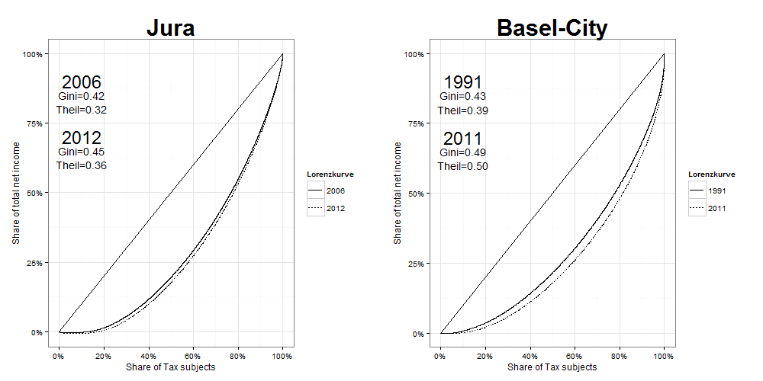
Results
Overall inequality over time
Notes:
Muss man sich noch überlegen, wie das genau dargestellt werden soll
<Nummer>

Slide 10
Results
Decomposing inequality by age groups
Notes:
Muss man sich noch überlegen, wie das genau dargestellt werden soll
<Nummer>

Slide 11
Results
Decomposing inequality by Households
Notes:
Muss man sich noch überlegen, wie das genau dargestellt werden soll
<Nummer>

Slide 12
Results
In depth distributional analysis of between agegroup differences and contribution of withingroup inequality to overall inequality
BS
Jura
Notes:
Muss man sich noch überlegen, wie das genau dargestellt werden solll
<Nummer>

Slide 13
Results
In depth distributional analysis of between agegroup differences and contribution of withingroup inequality to overall inequality
BS
Jura
Notes:
Muss man sich noch überlegen, wie das genau dargestellt werden solll
<Nummer>

Slide 14
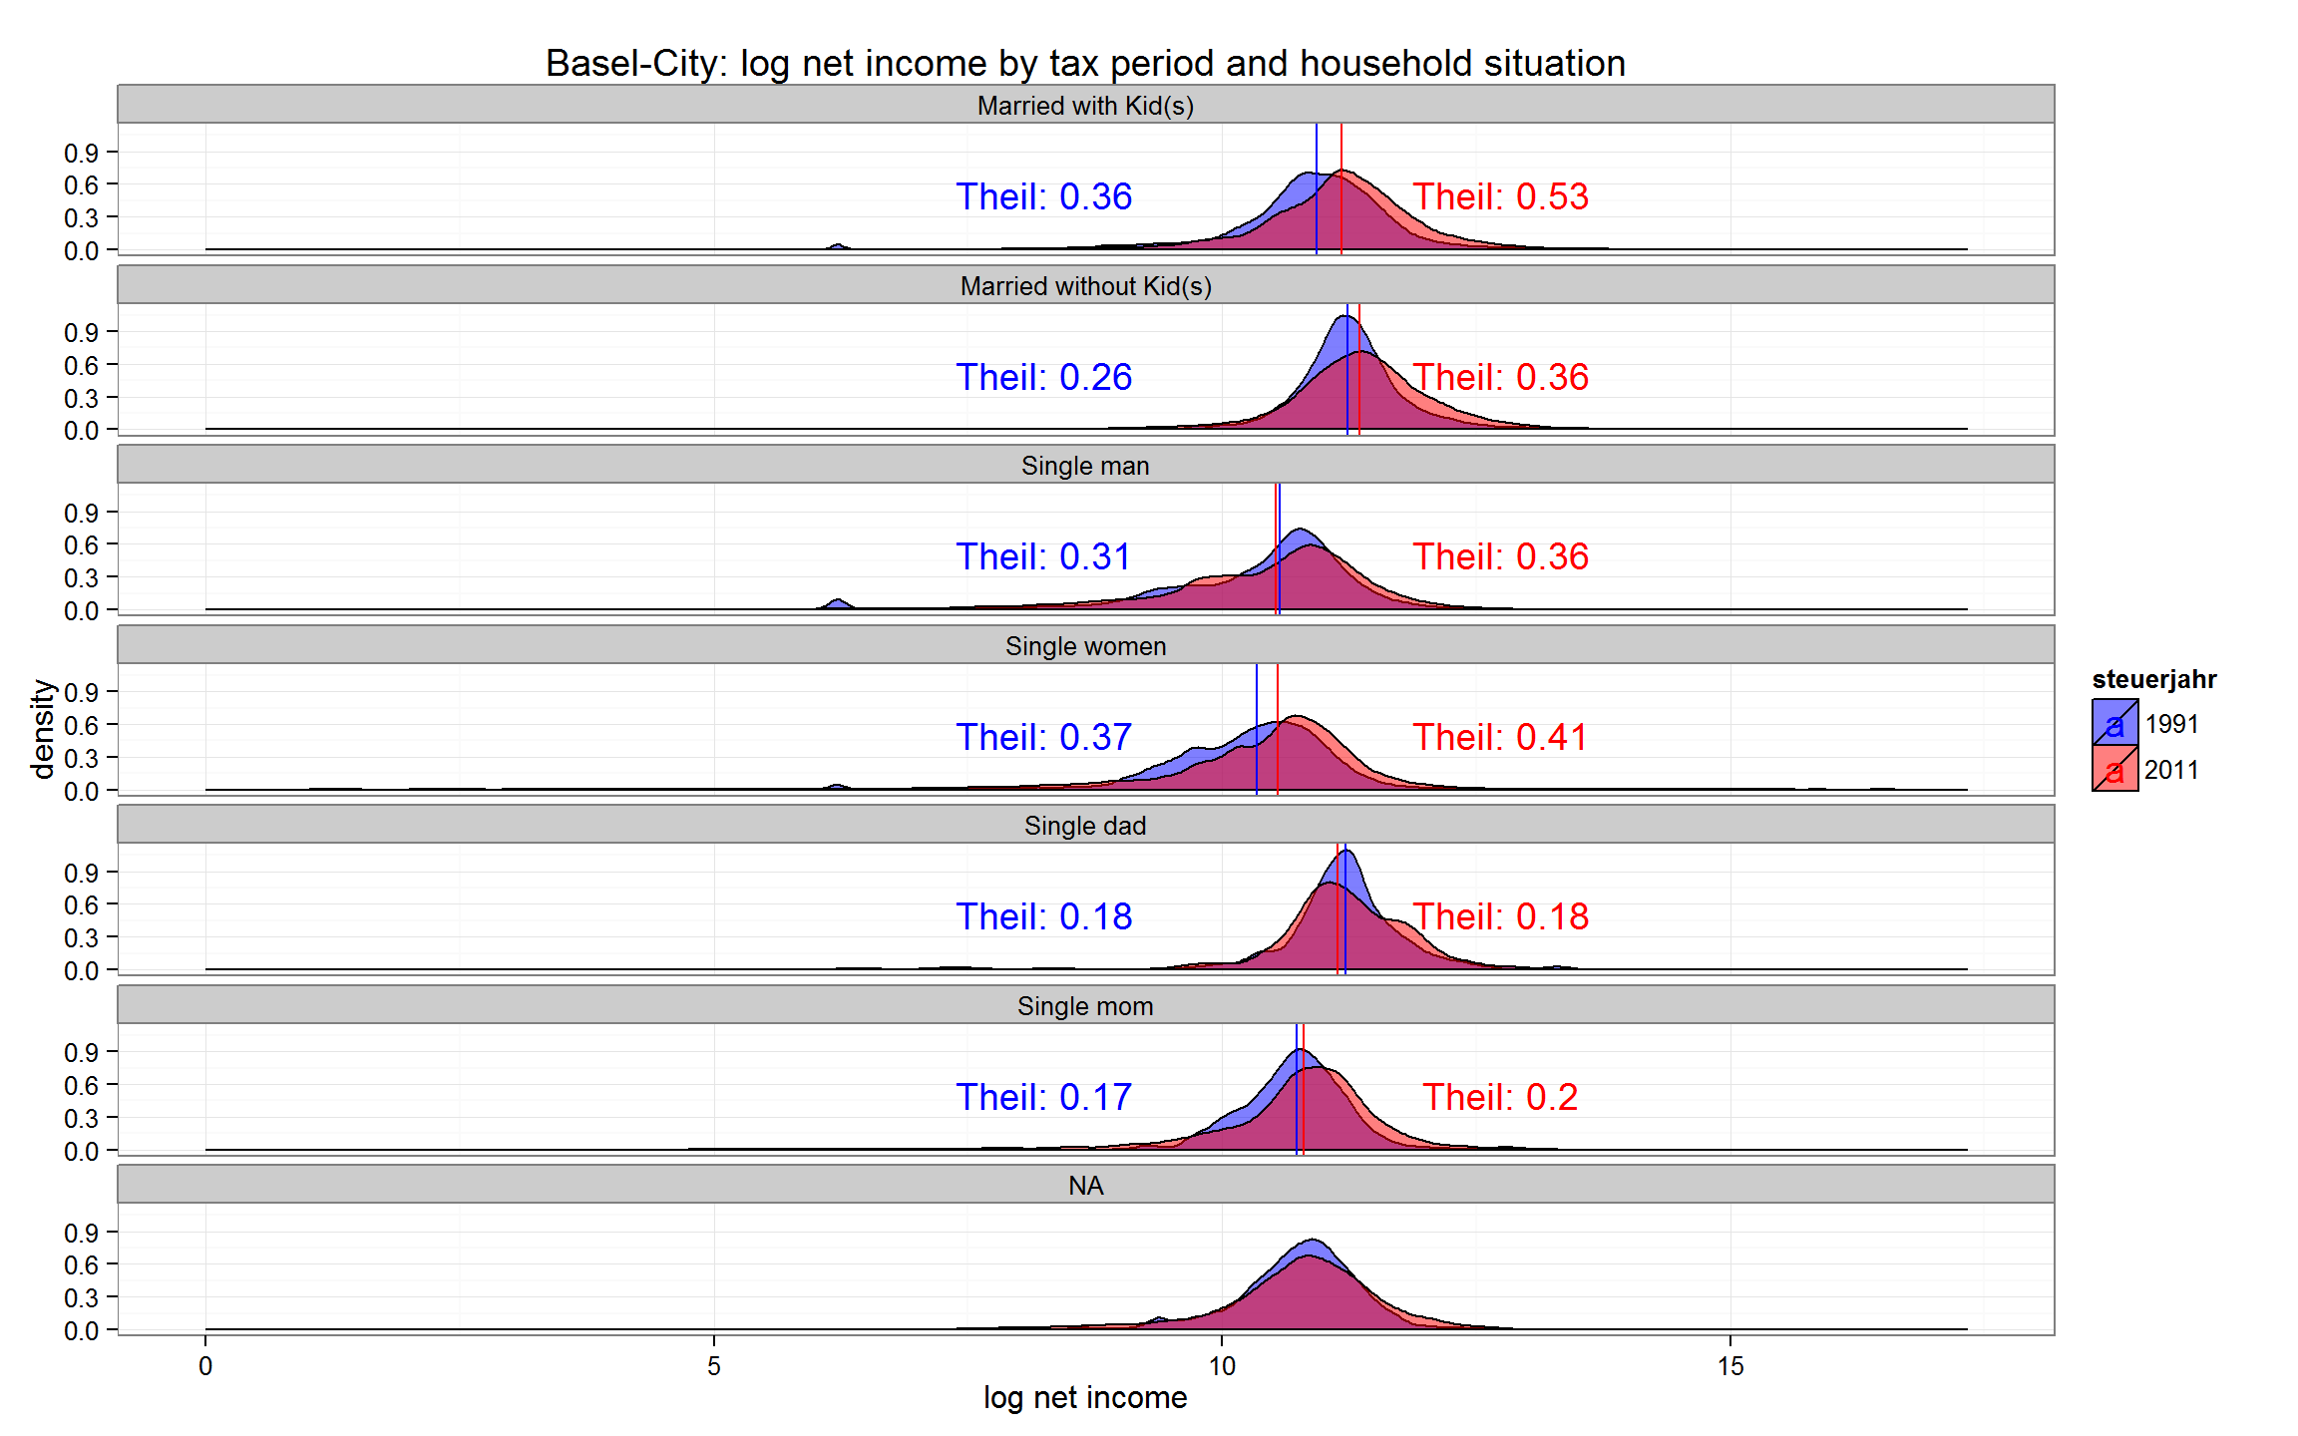

Slide 15
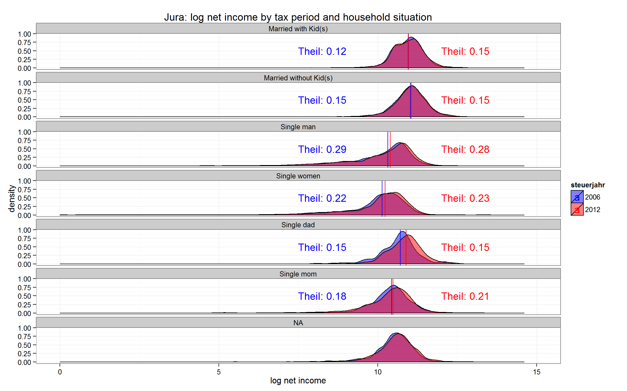

Slide 16
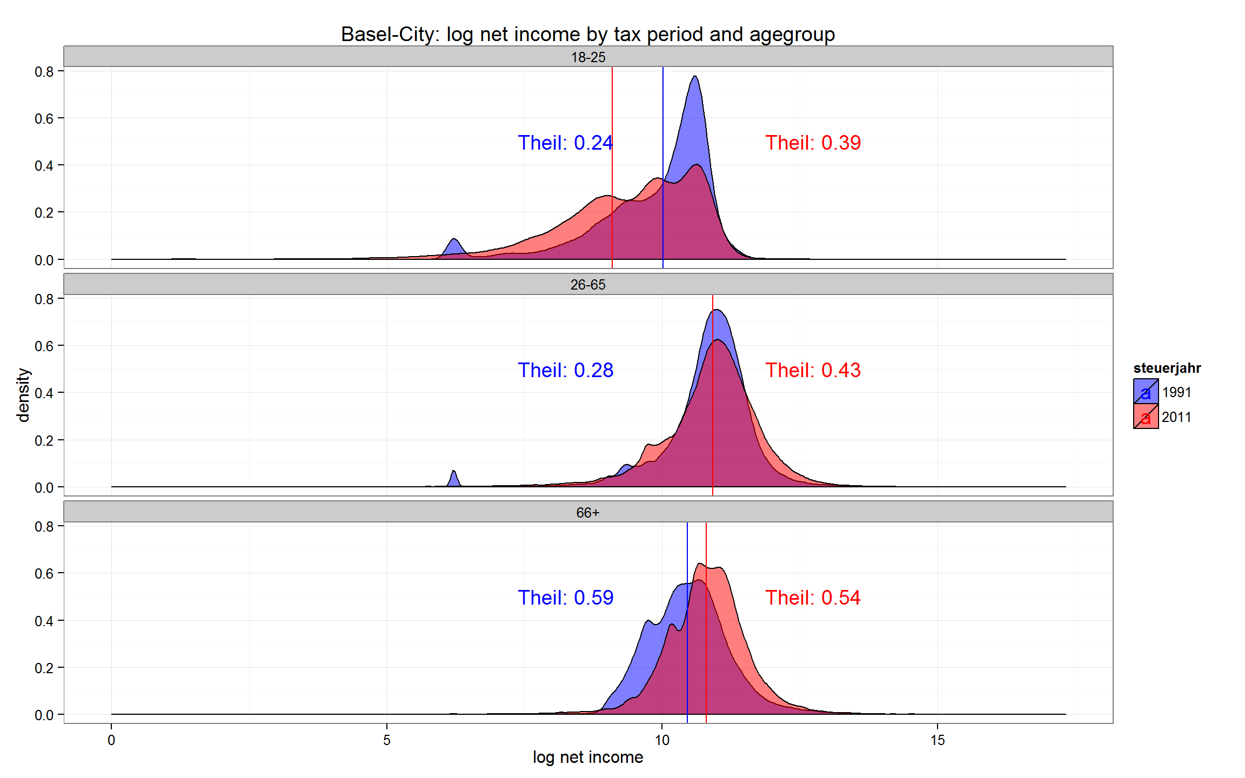

Slide 17
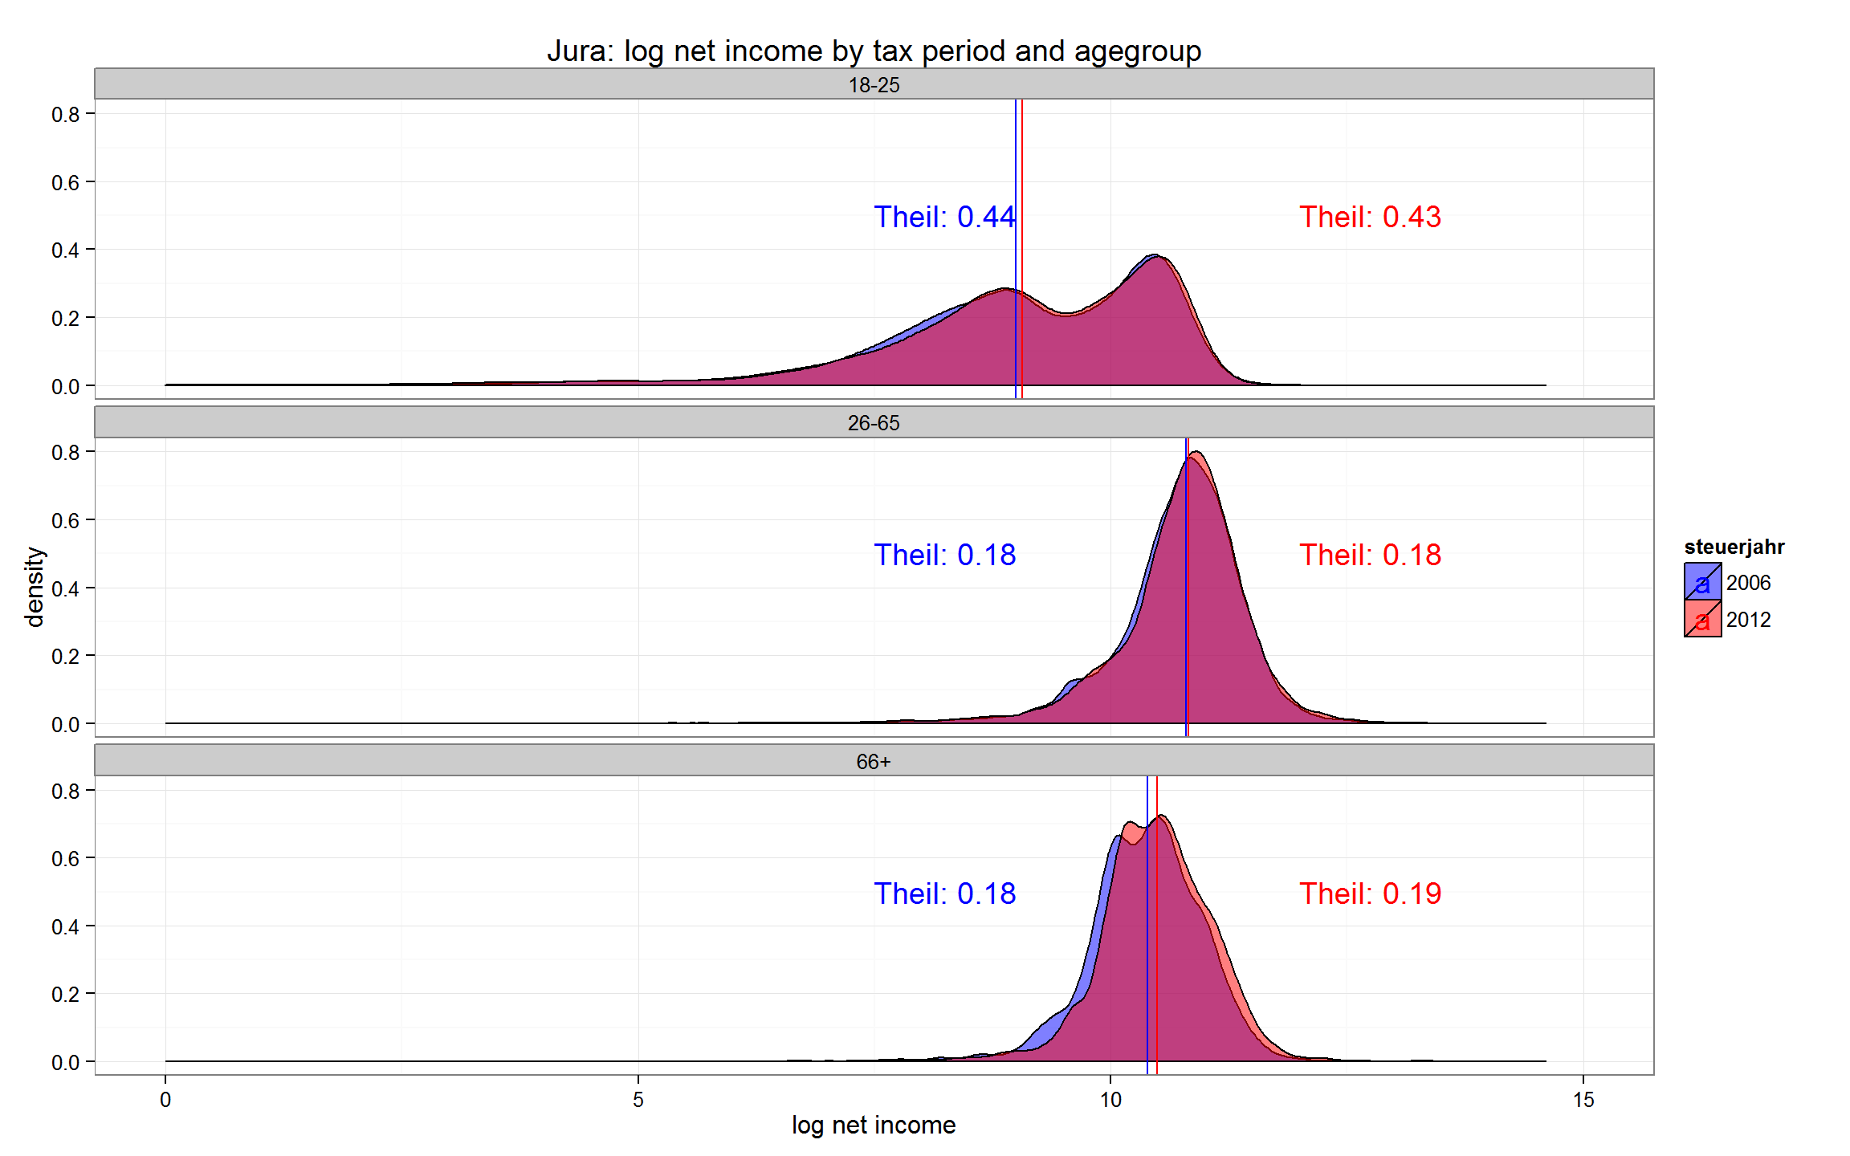

Slide 18
Interim Conclusion und outlook
Age groups
Between group is smaller than within group inequality > there are other relevant mechanisms
Within age group analysis show…
Household types
More people living alone
Between group differences seem to be relevant
Between group component contributed more to overall inequality over time
Within household typ analysis show…
Notes:
Muss man sich noch überlegen, wie das genau dargestellt werden solll
<Nummer>

Slide 19
Interim Conclusion und outlook
Median incomes rose for retired people
BS: Median incomes rose for married
BS: Inequality rose especially within <66y
BS:18-25 year old became more diverse
BS: single dads became bimodal
Notes:
Muss man sich noch überlegen, wie das genau dargestellt werden solll
<Nummer>

Slide 20
Hypotheses
Ageing of the population leads to a conflict between generations (Kaufmann 2005)
→ Indeed, inequality rose for working people and decreased for retired while
→ median incomes rose for retired people only
Rise in inequality in the US due to more people living alone (Daly/Valetta (2006)
→ Jura: Single households show higher inequality measures than married households
→ Basel: Inequality is rather high for married people with kids, so an increase in single households would not directly increase inequality
Notes:
Muss man sich noch überlegen, wie das genau dargestellt werden solll
<Nummer>

Slide 21
Results
Counterfactual model > with counterfactual decomposition we can examine the relationship in a more causal way
BS
Jura
Notes:
Muss man sich noch überlegen, wie das genau dargestellt werden solll
<Nummer>

